Slide 1
Rotated Square
Based on a puzzle by Catriona Shearer

Slide 2

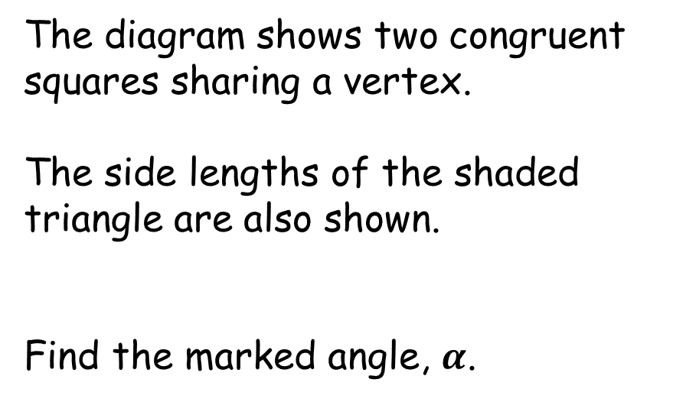



Rotated Square
The diagram shows two congruent squares sharing a vertex.
The side lengths of the shaded triangle are also shown.
Find the marked angle, $α$.
$$α$$
$$5$$
$$9$$
$$5$$
(Diagram not drawn to scale)
Notes:
From Catriona Shearer

Slide 3







Rotated Square
$90°+β+2γ=180°$
$β+2γ=90°$ (1)
$2γ+2α+β=180°$ (2)
$2α=90°$ (2)-(1)
$α=45°$
$$γ$$
$$α$$
$$5$$
$$β$$
$$γ$$
$$α$$
$$+$$
$$9$$
$$5$$
$$γ$$

Slide 4

Rotated Square
We didn’t use the given lengths so they were irrelevant!
$$45°$$
Notes:
0

Slide 5

Rotated Square
We didn’t use the given lengths so they were irrelevant!
$$45°$$
Notes:
1

Slide 6

Rotated Square
We didn’t use the given lengths so they were irrelevant!
$$45°$$
Notes:
2

Slide 7

Rotated Square
We didn’t use the given lengths so they were irrelevant!
$$45°$$
Notes:
3

Slide 8

Rotated Square
We didn’t use the given lengths so they were irrelevant!
$$45°$$
Notes:
4

Slide 9
Rotated Square
We didn’t use the given lengths so they were irrelevant!
$$45°$$
Notes:
3

Slide 10
Rotated Square
We didn’t use the given lengths so they were irrelevant!
$$45°$$
Notes:
2

Slide 11
Rotated Square
We didn’t use the given lengths so they were irrelevant!
$$45°$$
Notes:
1

Slide 12
Rotated Square
We didn’t use the given lengths so they were irrelevant!
$$45°$$
Notes:
0

Slide 13

Rotated Square
We didn’t use the given lengths so they were irrelevant!
$$45°$$
Notes:
-1

Slide 14

Rotated Square
We didn’t use the given lengths so they were irrelevant!
$$45°$$
Notes:
-2

Slide 15

Rotated Square
We didn’t use the given lengths so they were irrelevant!
$$45°$$
Notes:
-3

Slide 16

Rotated Square
We didn’t use the given lengths so they were irrelevant!
$$45°$$
Notes:
-4

Slide 17
Rotated Square
We didn’t use the given lengths so they were irrelevant!
$$45°$$
Notes:
-3

Slide 18
Rotated Square
We didn’t use the given lengths so they were irrelevant!
$$45°$$
Notes:
-2

Slide 19
Rotated Square
We didn’t use the given lengths so they were irrelevant!
$$45°$$
Notes:
-1

Slide 20
Rotated Square
We didn’t use the given lengths so they were irrelevant!
$$45°$$
Notes:
0

Slide 21
Rotated Square
Can you think of another way to solve this problem?
(Hint: Circle Theorems)
$$α$$

Slide 22




Rotated Square
circular arc,
centre $O$
$$α$$
“Angle at the centre is double the angle at the circumference”
$$O$$
$$2α$$
$2α=90°$
$α=45°$

Slide 24
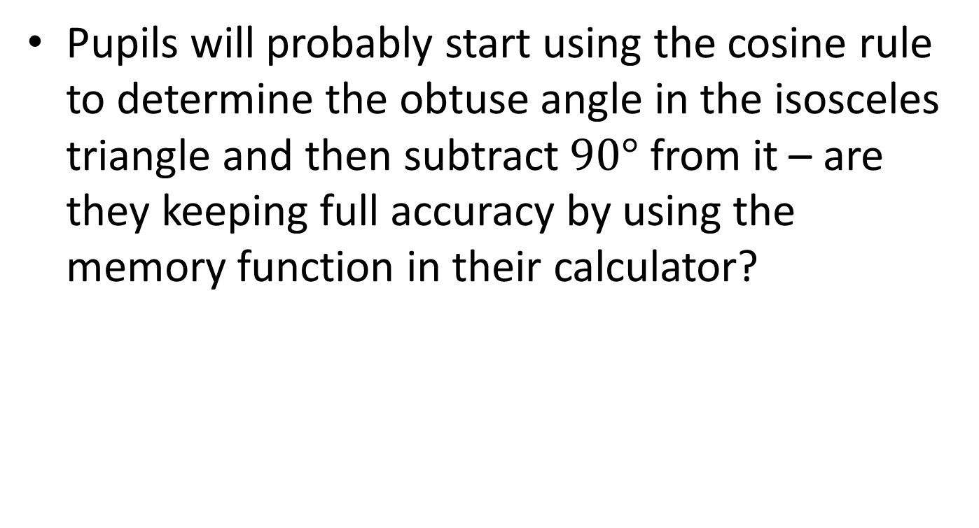
NOTE TO TEACHER
Pupils will probably start using the cosine rule to determine the obtuse angle in the isosceles triangle and then subtract $90°$ from it – are they keeping full accuracy by using the memory function in their calculator?

Slide 25
RESOURCES

Slide 26




Rotated Square
SIC_79
The diagram shows two congruent squares sharing a vertex.
The side lengths of the shaded triangle are also shown.
Find the marked angle, $α$.
$$α$$
$$10$$
$$19$$
$$10$$
(Diagram not drawn to scale)
A

Slide 27



Rotated Square
SIC_79
The diagram shows two congruent squares sharing a vertex.
The side lengths of the shaded triangle are also shown.
Find the marked angle, $α$.
$$α$$
$$10$$
$$18$$
$$10$$
(Diagram not drawn to scale)
B

Slide 28



Rotated Square
SIC_79
The diagram shows two congruent squares sharing a vertex.
The side lengths of the shaded triangle are also shown.
Find the marked angle, $α$.
$$α$$
$$10$$
$$17$$
$$10$$
(Diagram not drawn to scale)
C

Slide 29



Rotated Square
SIC_79
The diagram shows two congruent squares sharing a vertex.
The side lengths of the shaded triangle are also shown.
Find the marked angle, $α$.
$$10$$
$$α$$
$$16$$
$$10$$
(Diagram not drawn to scale)
D

Slide 30



Rotated Square
SIC_79
The diagram shows two congruent squares sharing a vertex.
The side lengths of the shaded triangle are also shown.
Find the marked angle, $α$.
$$10$$
$$α$$
$$15$$
$$10$$
(Diagram not drawn to scale)
E

Slide 31



Rotated Square
SIC_79
The diagram shows two congruent squares sharing a vertex.
The side lengths of the shaded triangle are also shown.
Find the marked angle, $α$.
$$α$$
$$12$$
$$23$$
$$12$$
(Diagram not drawn to scale)
F

Slide 32


Rotated Square
SIC_79
The diagram shows two congruent squares sharing a vertex.
The side lengths of the shaded triangle are also shown.
Find the marked angle, $α$.
$$α$$
$$12$$
$$22$$
$$12$$
(Diagram not drawn to scale)
G

Slide 33


Rotated Square
SIC_79
The diagram shows two congruent squares sharing a vertex.
The side lengths of the shaded triangle are also shown.
Find the marked angle, $α$.
$$α$$
$$12$$
$$20$$
$$12$$
(Diagram not drawn to scale)
H

Slide 34


Rotated Square
SIC_79
The diagram shows two congruent squares sharing a vertex.
The side lengths of the shaded triangle are also shown.
Find the marked angle, $α$.
$$12$$
$$α$$
$$19$$
$$12$$
(Diagram not drawn to scale)
I

Slide 35


Rotated Square
SIC_79
The diagram shows two congruent squares sharing a vertex.
The side lengths of the shaded triangle are also shown.
Find the marked angle, $α$.
$$12$$
$$α$$
$$18$$
$$12$$
(Diagram not drawn to scale)
J

Slide 36



Rotated Square
SIC_79
The diagram shows two congruent squares sharing a vertex.
The side lengths of the shaded triangle are also shown.
Find the marked angle, $α$.
$$α$$
$$16$$
$$30$$
$$16$$
(Diagram not drawn to scale)
K

Slide 37


Rotated Square
SIC_79
The diagram shows two congruent squares sharing a vertex.
The side lengths of the shaded triangle are also shown.
Find the marked angle, $α$.
$$α$$
$$16$$
$$29$$
$$16$$
(Diagram not drawn to scale)
L

Slide 38


Rotated Square
SIC_79
The diagram shows two congruent squares sharing a vertex.
The side lengths of the shaded triangle are also shown.
Find the marked angle, $α$.
$$α$$
$$16$$
$$27$$
$$16$$
(Diagram not drawn to scale)
M

Slide 39


Rotated Square
SIC_79
The diagram shows two congruent squares sharing a vertex.
The side lengths of the shaded triangle are also shown.
Find the marked angle, $α$.
$$16$$
$$α$$
$$26$$
$$16$$
(Diagram not drawn to scale)
N

Slide 40


Rotated Square
SIC_79
The diagram shows two congruent squares sharing a vertex.
The side lengths of the shaded triangle are also shown.
Find the marked angle, $α$.
$$16$$
$$α$$
$$24$$
$$16$$
(Diagram not drawn to scale)
O

Slide 41



Rotated Square
SIC_79
The diagram shows two congruent squares sharing a vertex.
The side lengths of the shaded triangle are also shown.
Find the marked angle, $α$.
$$α$$
$$15$$
$$28$$
$$15$$
(Diagram not drawn to scale)
P

Slide 42


Rotated Square
SIC_79
The diagram shows two congruent squares sharing a vertex.
The side lengths of the shaded triangle are also shown.
Find the marked angle, $α$.
$$α$$
$$15$$
$$26$$
$$15$$
(Diagram not drawn to scale)
Q

Slide 43


Rotated Square
SIC_79
The diagram shows two congruent squares sharing a vertex.
The side lengths of the shaded triangle are also shown.
Find the marked angle, $α$.
$$α$$
$$15$$
$$25$$
$$15$$
(Diagram not drawn to scale)
R

Slide 44


Rotated Square
SIC_79
The diagram shows two congruent squares sharing a vertex.
The side lengths of the shaded triangle are also shown.
Find the marked angle, $α$.
$$15$$
$$α$$
$$23$$
$$15$$
(Diagram not drawn to scale)
S

Slide 45


Rotated Square
SIC_79
The diagram shows two congruent squares sharing a vertex.
The side lengths of the shaded triangle are also shown.
Find the marked angle, $α$.
$$15$$
$$α$$
$$22$$
$$15$$
(Diagram not drawn to scale)
T

Slide 46



Rotated Square
SIC_79
The diagram shows two congruent squares sharing a vertex.
The side lengths of the shaded triangle are also shown.
Find the marked angle, $α$.
$$α$$
$$11$$
$$21$$
$$11$$
(Diagram not drawn to scale)
U

Slide 47


Rotated Square
SIC_79
The diagram shows two congruent squares sharing a vertex.
The side lengths of the shaded triangle are also shown.
Find the marked angle, $α$.
$$α$$
$$11$$
$$19$$
$$11$$
(Diagram not drawn to scale)
V

Slide 48


Rotated Square
SIC_79
The diagram shows two congruent squares sharing a vertex.
The side lengths of the shaded triangle are also shown.
Find the marked angle, $α$.
$$α$$
$$11$$
$$18$$
$$11$$
(Diagram not drawn to scale)
W

Slide 49


Rotated Square
SIC_79
The diagram shows two congruent squares sharing a vertex.
The side lengths of the shaded triangle are also shown.
Find the marked angle, $α$.
$$11$$
$$α$$
$$17$$
$$11$$
(Diagram not drawn to scale)
X

Slide 50


Rotated Square
SIC_79
The diagram shows two congruent squares sharing a vertex.
The side lengths of the shaded triangle are also shown.
Find the marked angle, $α$.
$$11$$
$$α$$
$$16$$
$$11$$
(Diagram not drawn to scale)
Y

